Slide 1
First plot in Matplotlib

Slide 2




Line Plot in
https://www.kharwal.com

Slide 3
Line Plots:
Line plots can be created by plot() function in Matplotlib.

Slide 4
Features of plot function

Slide 5
The following is a list of commonly defined features:
Line Width,
Line Style,
Line Color,
Line Opacity,
Marker Options,
Grid,
Legend

Slide 6
Line Width

Slide 7
linewidth=<float or int> Line Width
0.5 0.5 pixels wide
1 1 pixel wide
1.5 1.5 pixels wide
2 2 pixels wide
3 3 pixels wide

Slide 8
Line Style

Slide 9
linestyle='<style abbreviation>' Line Style
'-' or 'solid' solid line (default)
'--' or 'dashed' dashed line
'-.' or 'dashdot' dash-dot line
':' or 'dotted' dotted line
'None' or ' ' or '' no line

Slide 10
Line Color

Slide 11
color ='<color abbreviation>' Color Name
'b' blue
'c' cyan
'g' green
'k' black
'm' magenta
'r' red
'w' white
'y' yellow

Slide 12
Alpha Values

Slide 13
Alpha values (opacity): any alpha value between 0.0 and 1.0 is possible.
alpha = <float or int> Opacity
0 transparent
0.5 half transparent
1.0 opaque

Slide 14
An example plt.plot() function call including line color, line width, and line style options is:
plt.plot(x, y,
linewidth=2.0,
linestyle='+',
color='b',
alpha=0.5,
marker='o')

Slide 15
Marker Styles

Slide 16
marker='<marker abbreviation>' Marker Style
'.' point
',' one pixel
'o' circle
'v' triangle_down
'^' triangle_up
'8' octagon
's' square
'p' pentagon
'*' star

Slide 17
'h' hexagon 1
'H' hexagon 2
'+' plus
'P' filled plus
'x' x
'X' filled x
'D' diamond
'd' thin diamond

Slide 18

Thank you!
Please like & subscribe our channel.

Slide 19
Legend

Slide 20
You can use the plt.legend() command to insert a legend on a plot.
The legend appears within the plot area, in the upper right corner by default.
The plt.legend() command accepts a list of strings and optionally accepts a loc= argument to specify the legend location.
plt.legend(['entry1','entry2'], loc = 0)

Slide 21
The following are the legend location codes. These numbers need to be placed after loc= in the plt.legend() call.
Legend Location loc = <number>
'best' 0
'upper right' 1
'upper left' 2
'lower left' 3
'lower right' 4
'right' 5

Slide 22
'center left' 6
'center right' 7
'lower center' 8
'upper center' 9
'center' 10

Slide 23
Grid

Slide 24
A grid can be added to a Matplotlib plot using the plt.grid() command. By defaut, the grid is turned off.
To turn on the grid use: plt.grid(True)
The only valid options are plt.grid(True) and plt.grid(False).

Slide 25
Tick Label

Slide 26
Tick labels can be specified on a Matplotlib plot using plt.xticks() and plt.yticks().
To add tick labels use:
plt.xticks([locations list],[labels list])
plt.yticks([locations list],[labels list])
The [locations list] can be a Python list or NumPy array of tick locations . The [labels list] is a Python list or NumPy array of strings.

Slide 27
Syntax:
plt.plot(<x-data>,<y-data>,
linewidth=<float or int>,
linestyle='<linestyle abbreviation>',
color='<color abbreviation>',
alpha=<float or int>,
marker='<marker abbreviation>')

Slide 28
An example plt.plot() function call including line color, line width, and line style options is:
plt.plot(x, y,
linewidth=2.0,
linestyle='+',
color='b',
alpha=0.5,
marker='o')

Slide 36
Types of Plot

Slide 37
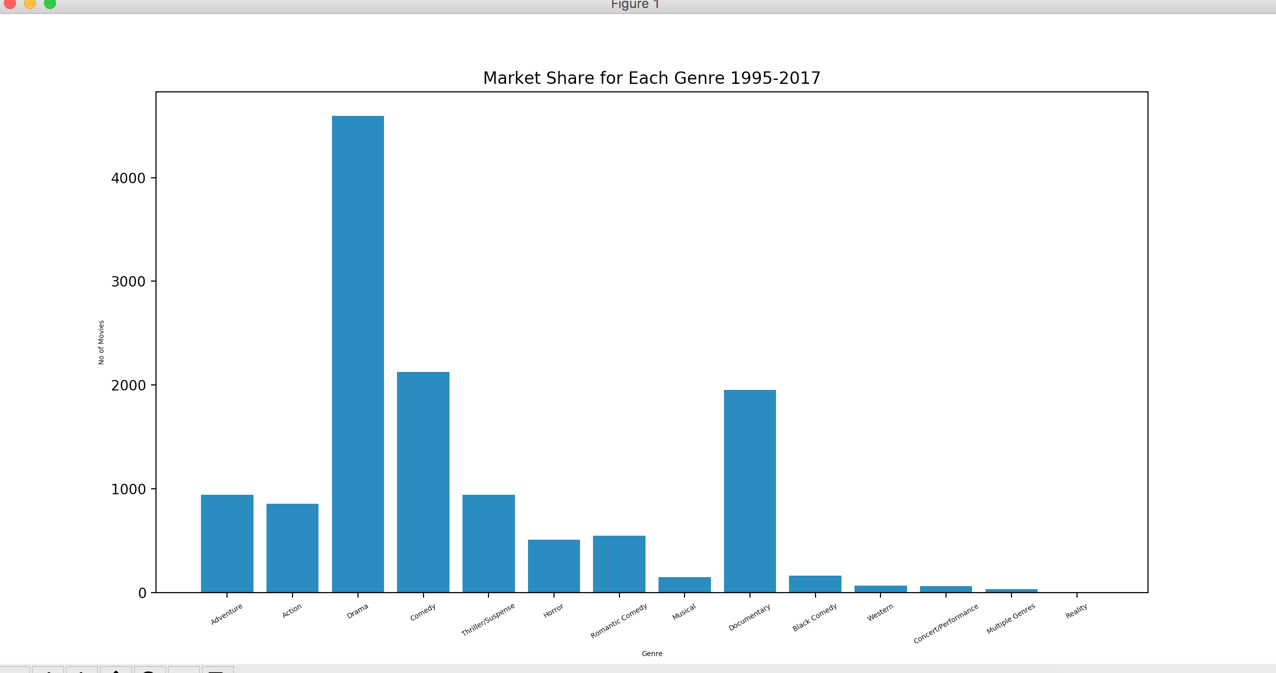
Bar Graph

Slide 38
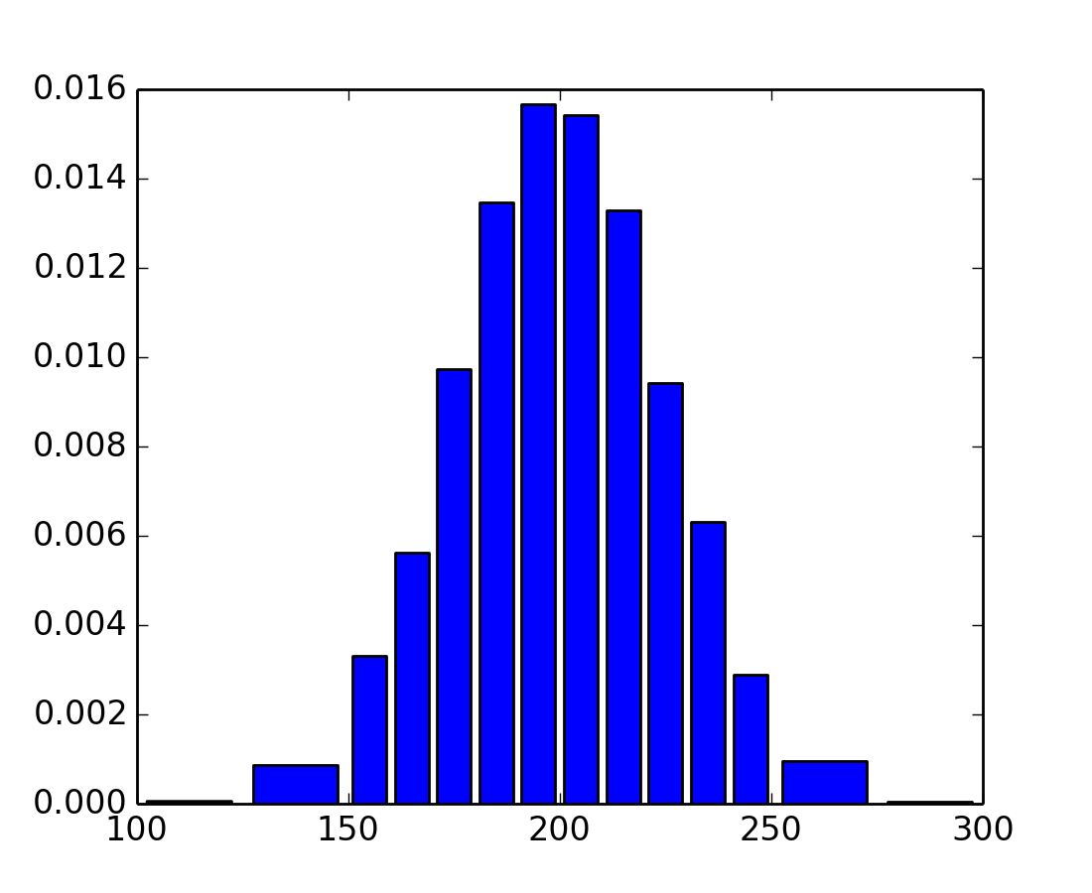
Histogram Graph

Slide 39
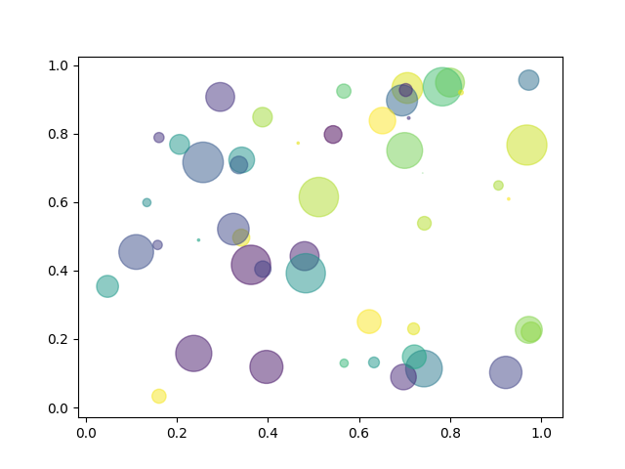
Scatter Plot

Slide 40
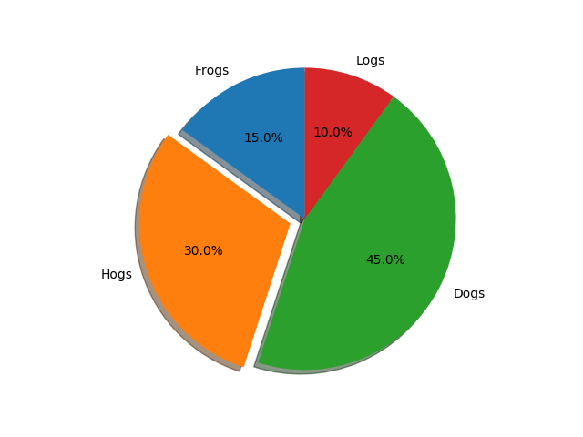
Pie Plot

Slide 41
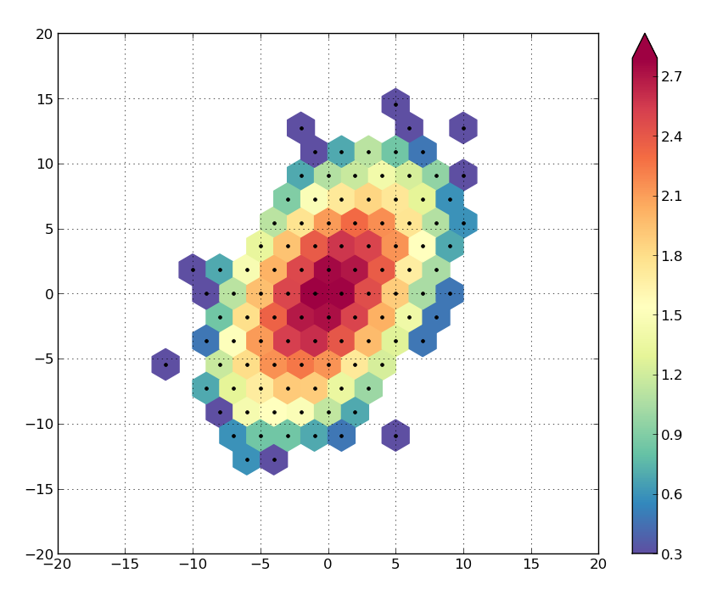
Hexbin Plot

Slide 42
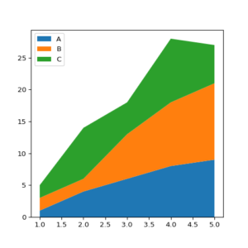
Area Plot

Slide 43
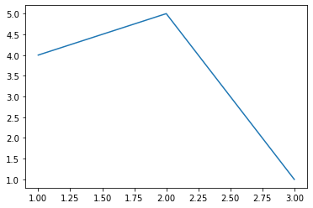
Create First Plot:
from matplotlib import pyplot as plt
plt.plot([1,2,3],[4,5,1])
plt.show

Slide 44
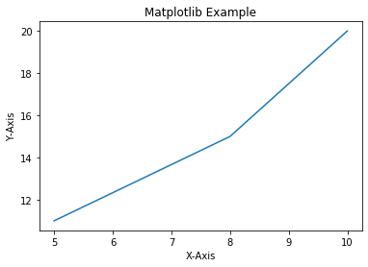
Add Labels and Title to Plot:
from matplotlib import pyplot as plt
x=[5,8,10]
y=[11,15,20]
plt.plot(x,y)
plt.title('Matplotlib Example')
plt.xlabel('X-Axis')
plt.ylabel('Y-Axis')
plt.show()

Slide 45
Add Styles to Plot:
from matplotlib import style
style.use('ggplot')
x1=[5,8,10]
y1=[12,16,23]
x2=[17,13,45]
y2=[15,20,30]
plt.plot(x1,y1,'g',label='Line One',linewidth=5)
plt.plot(x2,y2,'c',label='Line Two',linewidth=5)

Slide 46
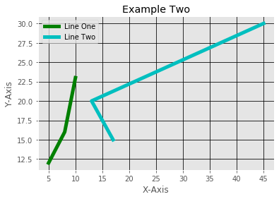
plt.title('Example Two')
plt.xlabel('X-Axis')
plt.ylabel('Y-Axis')
plt.legend()
plt.grid(True,color='k')
plt.show()

Slide 47
Bar Plot:
x1=[5,8,10]
y1=[12,16,23]
x2=[17,13,45]
y2=[15,20,30]
plt.bar(x1,y1,label='Example One')
plt.bar(x2,y2,label='Example Two')
plt.legend()
plt.xlabel('X-axis')
plt.ylabel('Y-axis')

Slide 48
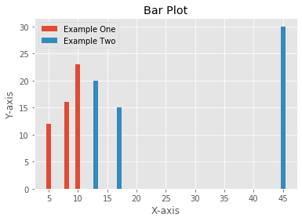
plt.title('Bar Plot')
plt.show()

Slide 49
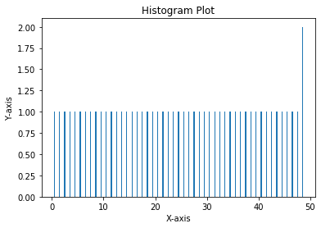
Histogram:
pa=range(50)
bins=range(50)
plt.hist(pa,bins,histtype='bar',rwidth=0.2)
plt.xlabel('X-axis')
plt.ylabel('Y-axis')
plt.title('Histogram Plot')
plt.show()

Slide 50
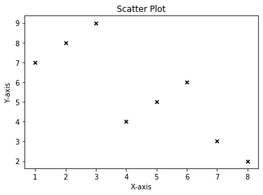
Scatter Plot:
x3=[1,2,3,4,5,6,7,8]
y3=[7,8,9,4,5,6,3,2]
plt.scatter(x3,y3,label='Arvind',color='k',s=25,marker='x')
plt.xlabel('X-axis')
plt.ylabel('Y-axis')
plt.title('Scatter Plot')
plt.show()

Slide 51
Stack Plot:
D=[1,2,3,4,5]
S=[7,8,6,11,7]
E=[2,3,4,3,2]
W=[7,8,7,2,2]
P=[8,5,7,8,13]
plt.plot([],[],color='m',label='D',linewidth=5)
plt.plot([],[],color='c',label='S',linewidth=5)
plt.plot([],[],color='r',label='E',linewidth=5)
plt.plot([],[],color='k',label='W',linewidth=5)
plt.plot([],[],color='g',label='P',linewidth=5)

Slide 52
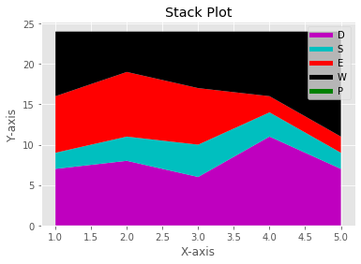
plt.stackplot(D,S,E,W,P,colors=['m','c','r','k','y'])
plt.legend()
plt.xlabel('X-axis')
plt.ylabel('Y-axis')
plt.title('Stack Plot')
plt.show()

Slide 53
Pie Plot:
slices=[7,2,4,3]
Name=['A','B','C','D']
clrs=['c','m','r','b']
plt.pie(slices,
labels=Name,
colors=clrs,
startangle=90,
shadow=True,
explode=(0,0.1,0,0),
autopct='%.2f%%'
)

Slide 54
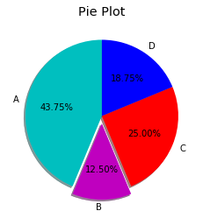
plt.title('Pie Plot')
plt.show()

Slide 55
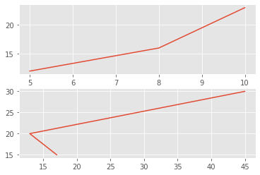
Working With Multiple Plots:
x1=[5,8,10]
y1=[12,16,23]
x2=[17,13,45]
y2=[15,20,30]
plt.subplot(211)
plt.plot(x1,y1)
plt.subplot(212)
plt.plot(x2,y2)
plt.show()

Slide 56
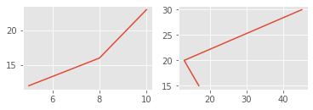
x1=[5,8,10]
y1=[12,16,23]
x2=[17,13,45]
y2=[15,20,30]
plt.subplot(221)
plt.plot(x1,y1)
plt.subplot(222)
plt.plot(x2,y2)
plt.show()

Slide 57
Plt.subplot(211)
2 means we have 2 plots in this plot.
1 means Horizontally we have only one plot
1 means this is plot number 1

